Slide 1


Java 8
Java User Group – Zielona Góra
Paweł Żalejko
@pzalejko

Slide 2
Agenda
Java – short history
What's New in JDK 8
  JavaFX, Nashorn
  Annotations
  Default methods
  Lambda expressions
  Method References
  Functional programming & Stream API
  ...

Slide 3
Java - history
1.0 (January 23, 1996)
1.1 (February 19, 1997)
1.2 (December 8, 1998)
1.3 (May 8, 2000)
1.4 (February 6, 2002)
5 (September 30, 2004)
6 (December 11, 2006)
7 (July 28, 2011)
8 (March 18, 2014)
9 (2016?)

Slide 4
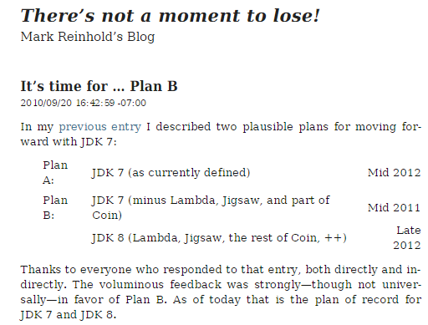
Java 8 – Plan B
http://openjdk.java.net/projects/jdk8/

Slide 5
Java 8
Java 8 update 31
Java 8 update 40(March 2015)
  http://openjdk.java.net/projects/jdk8u/releases/8u40.html

Slide 6
Metaspace
Native memory
Eden
Survivor
OLD GEN
PERM GEN
NEW GEN
PERM GEN

Slide 7
Compact Profiles
Three profiles:
  Compact1
  Compact2
  Compact3
Compact profiles address API choices only
The full SE API is a superset of the compact3 profile
javac -profile <profile>
JEP 161: Compact Profiles: http://openjdk.java.net/jeps/161

Slide 8
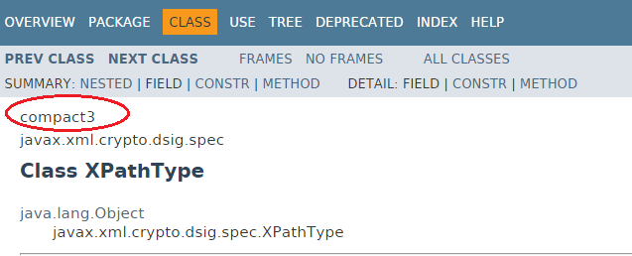
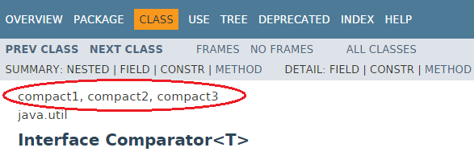
Compact Profiles

Slide 9
JEP (JDK Enhancement Proposal)
  java.util.Base64
  ( http://openjdk.java.net/jeps/135 )

Slide 10
Nashorn
JavaScript Engine for the JVM
Can be used as:
  a command line tool(jjs.exe)
  an embedded interpreter in Java applications
Java code can call JavaScript code, and vice versa
Nashorn uses the invokedynamic JVM instruction

Slide 11
JavaFX
HTML5 improvements via WebView (including the use of Nashorn)
New controls, such as TreeTableView and DatePicker
The new Modena GUI theme
Support for Touch-Enabled Devices
  Multi-touch support for tablets
  Virtual Keyboard
JavaFX 8 (update 40) finally includes simple Dialogs and Alerts!

Slide 12
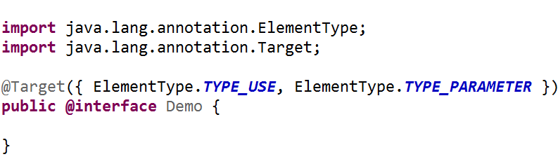
Annoations(JSR 308)
Type Annotations
  TYPE_USE
  TYPE_PARAMETER (e.g. MyClass<T>)

Slide 13
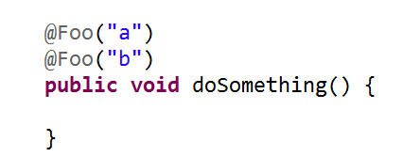
Repeating Annotations

Slide 14
Demo
Nashorn & Annotations

Slide 15
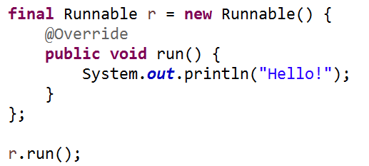

Lambda expressions(JSR 335)
Functional Interface

Slide 16
Lambda expressions(JSR 335)
Closures, anonymous methods/functions
Function that takes input parameters and produces a result
Are not anonymous classes
Invoked as a new method(invokedynamic)
Cannot throw checked exceptions
Local variables must be final or effectively final
Functional interfaces
Syntax of Lambda Expressions:
(params) -> statement

Slide 17
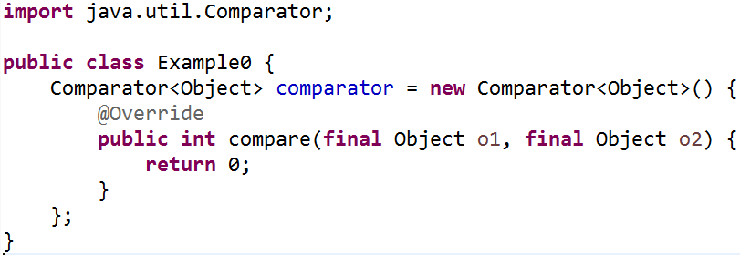
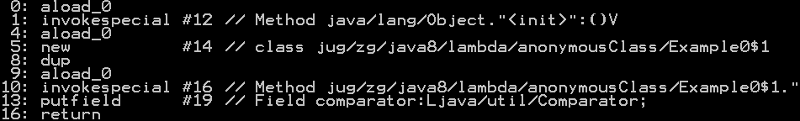
Lambda expressions: under the hood
javap -c -v Example0

Slide 18
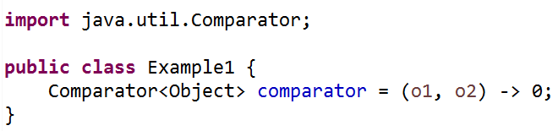

Lambda expressions: under the hood(2)
javap -c -v Example1

Slide 19
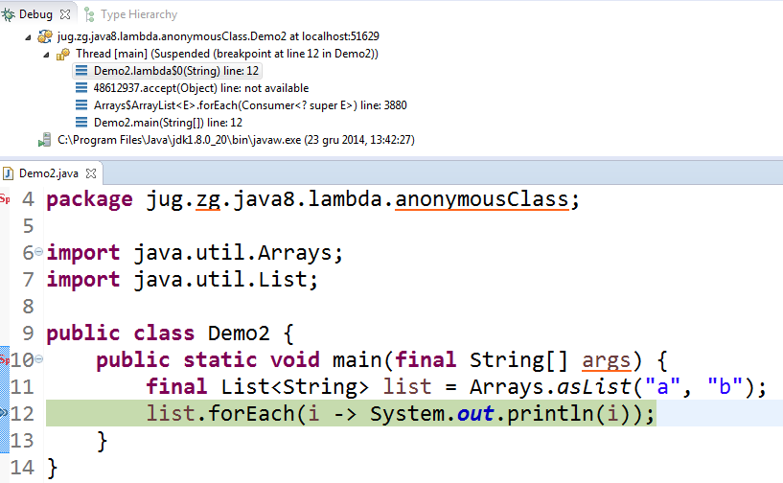
Lambda expressions: runtime

Slide 20
Method References(JSR 335, part C)
Lambda expressions for existing methods
Kind | Example
Reference to a static method | Person::staticMethodName
Reference to an instance method of a particular object | person::getAge
Reference to an instance method of an arbitrary object of a particular type | String::compareToIgnoreCase
Reference to a constructor | Person::new

Slide 21
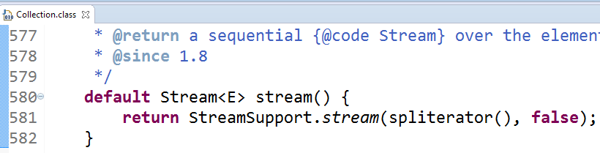
Default methods(JSR 335, part H)
Allow for adding new methods to existing interfaces
Default and static methods do not break the functional interface contract
Can be dangerous(multiple inheritance?)
Examples(java.util.Collection):

Slide 22
Demo
Lambdas & Method References & Default methods

Slide 23
Functional programming
@FunctionalInterface
  „Functional interface has exactly one abstract method.”
Functional interfaces in Java 8:
  Optional<T>
  Supplier<T>
  Consumer<T>
  Function<T, R>
  BiFunction<T, U, R>
  Predicate<T>
  ...

Slide 24
Stream API
„A sequence of elements supporting sequential and parallel aggregate operations”
Streams are not:
  Collections
  Sequences
  Iterators
Stream is an abstraction over objects
  „a query on the stream source”

Slide 25
Stream API
java.util.stream.Stream Interface
Streams can be obtained in a number of ways:
  stream() method
  Arrays.stream(Object[]);
  Stream.of(Object[]);
  java.nio.file.Files, java.io.BufferedReader etc.

Slide 26
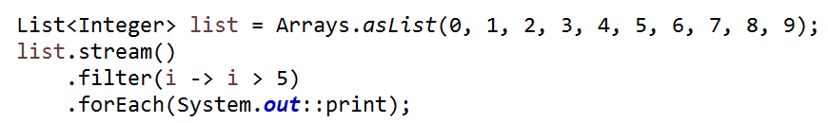
Stream API
A stream consists of:
  zero or more intermediate operations
  a terminal operation
Streams are lazy: computation on the source data is only performed when the terminal operation is initiated.
Example:

Slide 27
Parallel Streams
Fork/Join framework
Parallel streams use a common ForkJoinPool
Long-running tasks should be avoided
Parallel streams can be slower than sequential streams

Slide 28
Demo
Functional programming & Streams

Slide 29
What else?
Concurrency
  java.util .Arrays.parallelSort(...) methods
  StampedLock, LongAdder, CompletableFuture etc.
A new Date and Time API
Java ME 8 Device Access API
  GPIO (General Purpose Input Output) pins
  I2C (Inter-Integrated Circuit Bus)
Tools
  Jdeps: Command-line Static Dependency Checker

Slide 30
Thanks!

